Slide 1
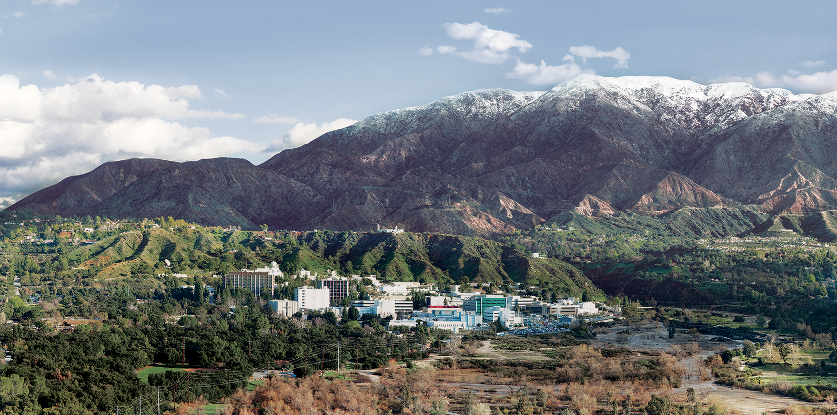
5. Linear Mixture Models
Dr. David R. Thompson
Jet Propulsion Laboratory, Imaging Spectroscopy Group
July 20, 2019

Slide 2
Goals for this module
Understand the difference between linear and nonlinear mixing
Apply mixture models to synthesize mixed-pixel spectra
Unmix spectra with a spectral library

Slide 3
Q: When does linear dimensionality reduction work well for our datasets?
A: When spectra “live” in a mostly-linear subspace.
Credit: wikimedia

Slide 4
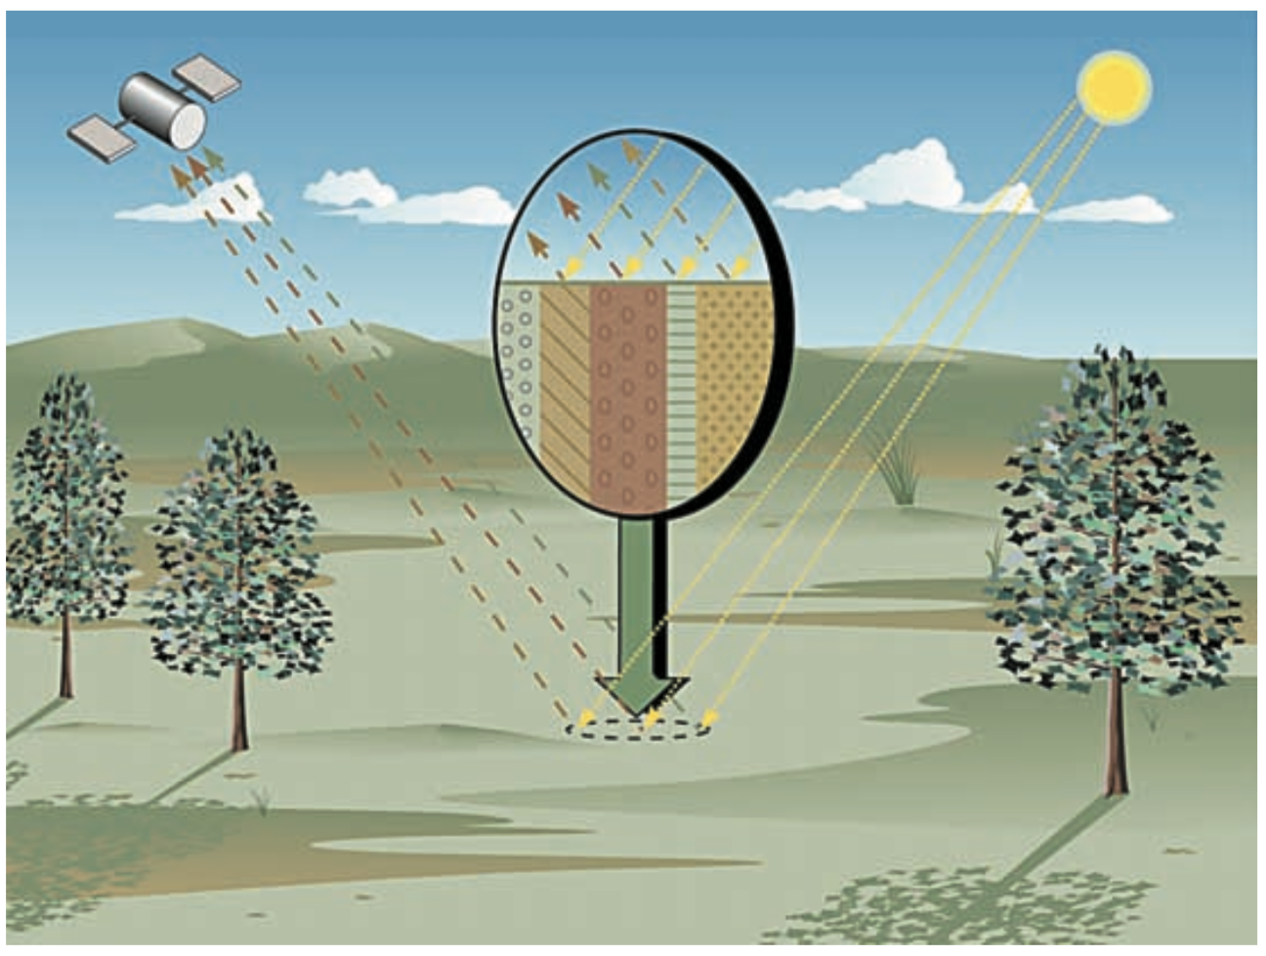
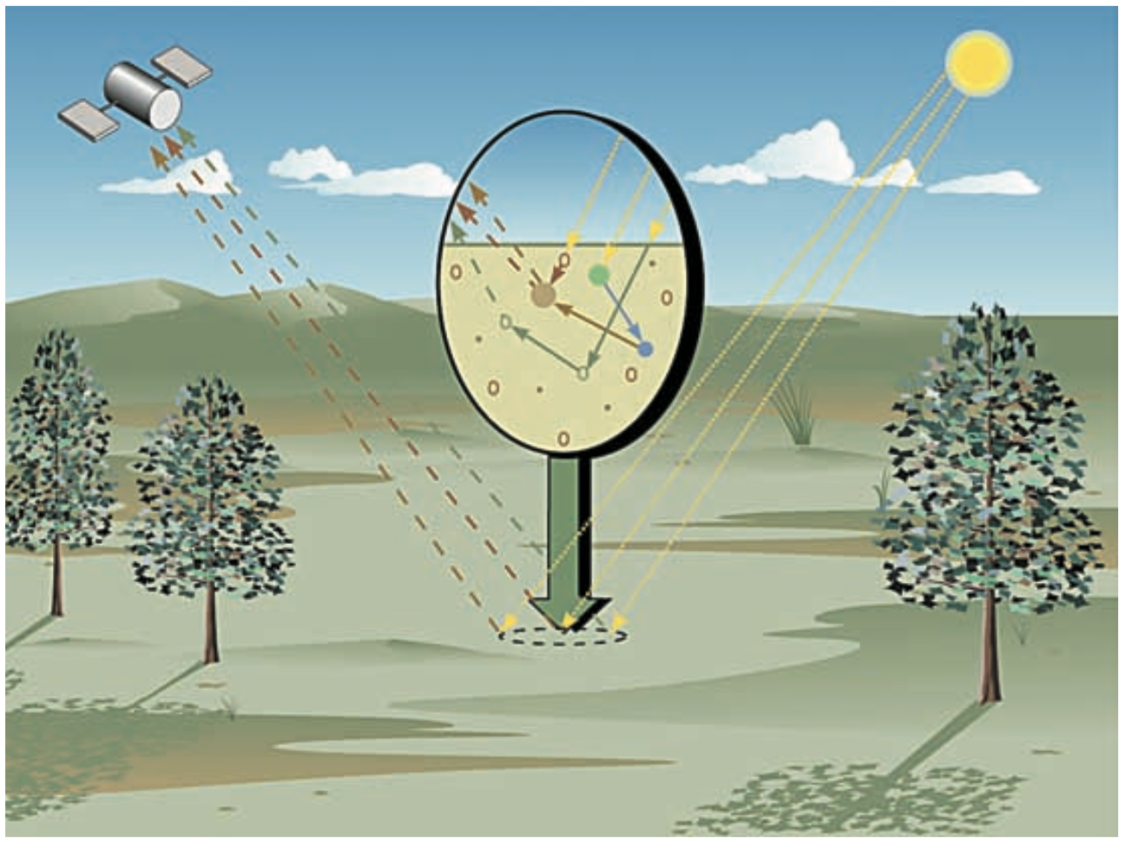
Linear vs. nonlinear mixtures of spectra
Linear “geographic” or “areal” mixing is where spectra combine in in geographic proportion, a “checkerboard model” that is effective for many applications.
Nonlinear “intimate” mixing is a combination of scattering and reflection/absorption events. Minerals, tree canopies, urban environments, etc.
Credit: Keshava and Mustard, IEEE Signal Proc. Mag., 2002

Slide 5
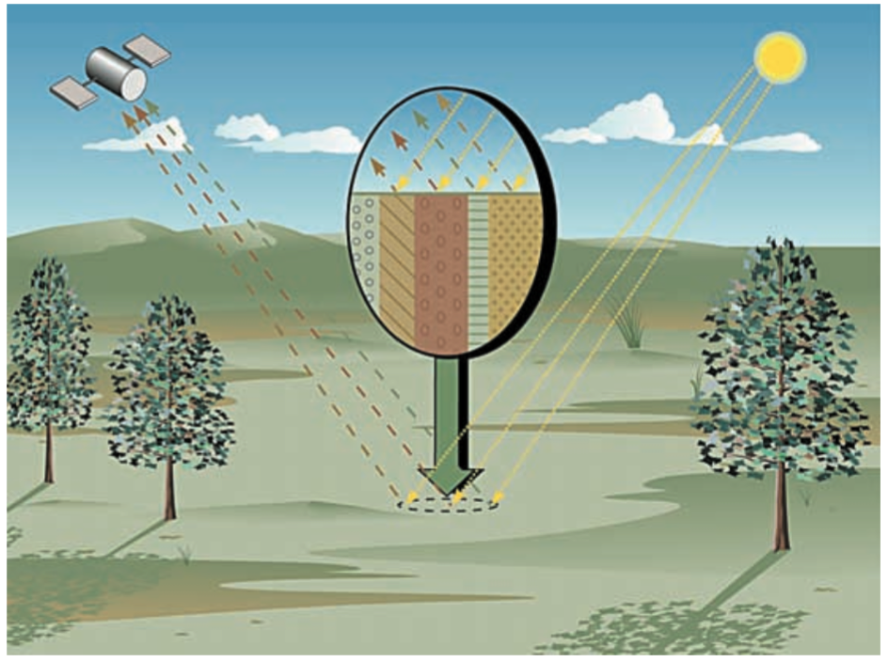
Reflectance: The Linear / Geographic mixing model
r(λ) = Σ_{i} a_{i}(λ) b_{i}
Observed reflectance
Library spectrum
Mixing fraction
Geographic mixing (Linear model)
[Keshava and Mustard, IEEE 2002]

Slide 6
Unmixing with Multiple Endmember Spectral Mixture Analysis
Observed reflectance
in wavelength j
Library spectrum
Mixing fraction
Measurement noise
A nonnegative least squares problem (all b_{i} ≥ 0)
MESMA (Roberts et al., RSE 2003) finds the optimal compact combination of library endmembers to reproduce observations
Minimizes per-channel RMSE

Slide 7
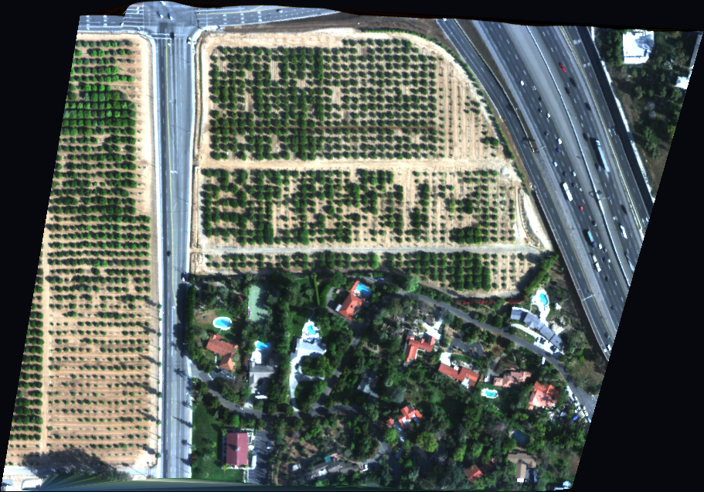
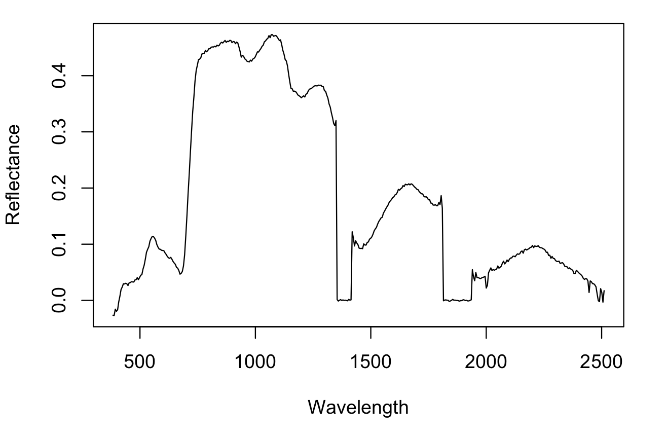
Example of geographic mixing models: Surface reflectance in Visible Short Wave InfraRed, acquired by a Next Generation Imaging Spectrometer
Chlorophyll
Liquid Water absorption
Water vapor absorption

Slide 8
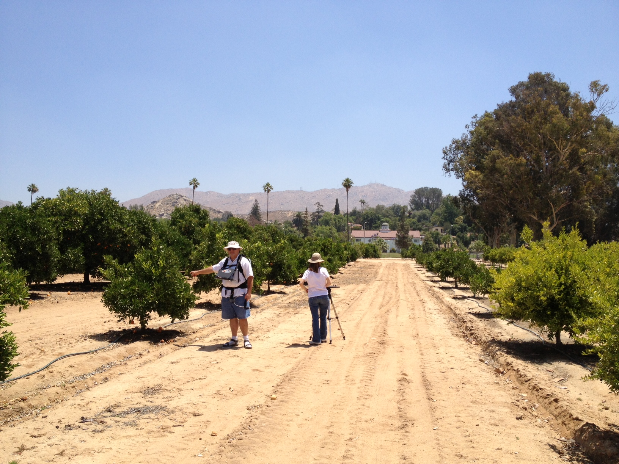
What surfaces are evident?
Leaves
Shade
Dirt

Slide 9
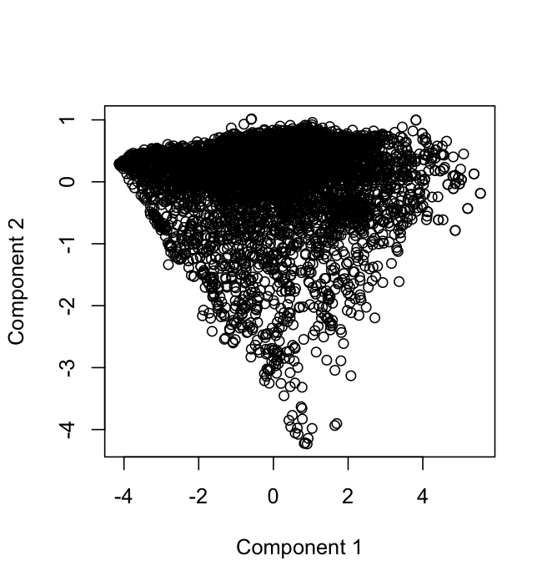
Example: shade, soil, and green vegetation in an orchard
green
vegetation
PCA Reduction
shade
soil

Slide 10
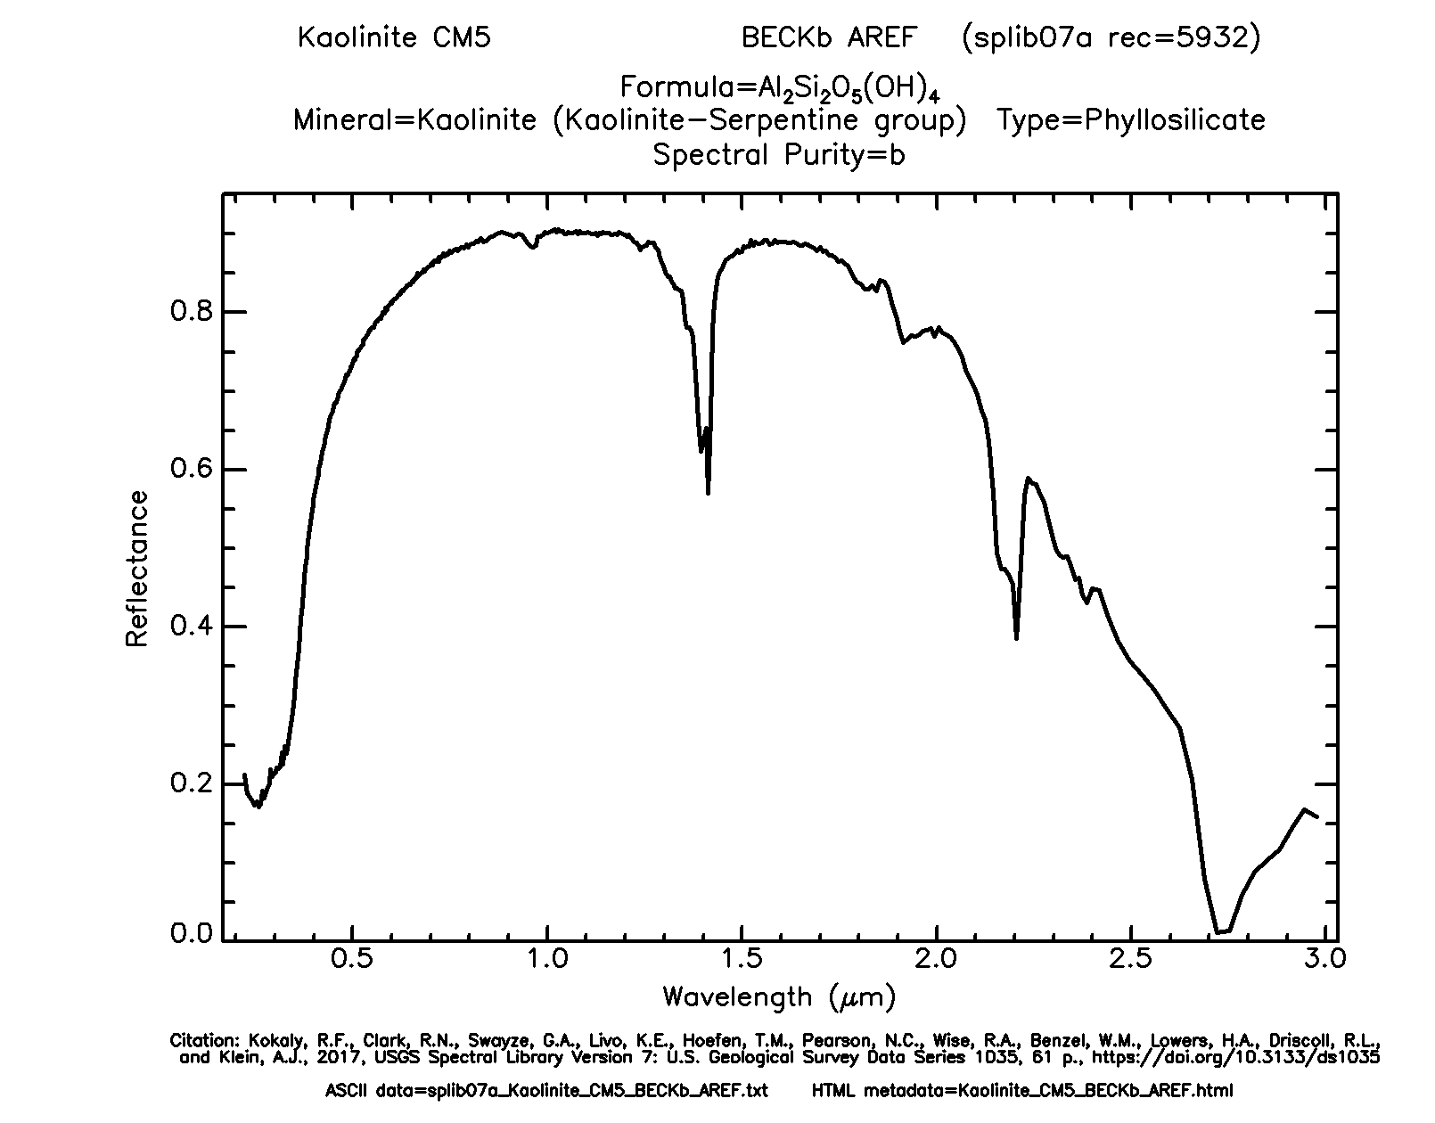
Continuum approximation
Absorptions
Continuum
?

Slide 11
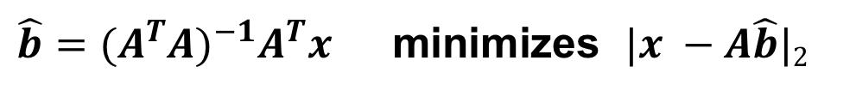
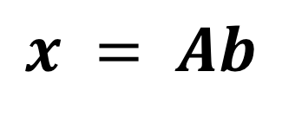
Common ways to invert the linear mixture:
$$x = Ab$$
Standard least squares minimization:
Nonnegative least squares (Lawson/Hansen algorithm, iterative):
Measured spectrum
A library matrix where columns are spectra
Vector of mixing coefficients
$\hat{b}={(A^{T}A)}^{−1}A^{T}x$ minimizes $|x −A\hat{b}|2$
$\hat{b}=f\left(A,x\right)$ minimizes $\left|x −A\hat{b}\right|2 S.T. \hat{b}≥0$

Slide 13
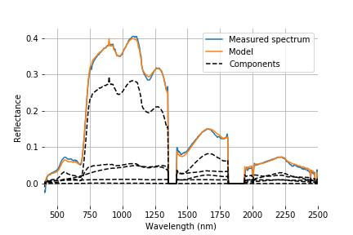
Exercise 5: Spectral unmixing
Objective: Unmix the list of spectra in the citrus orchard overflight.
Plot the model fits and nonzero component spectra for some representative examples. The right panel shows spectrum #1000.
Extra credit: interpret your endmembers, and find the mixture fractions of vegetation, nonphotosynthetic vegetation, soil and shade.

